Slide 1
CIS 5525: Neural Computation
Week III: Autoencoder and Deep Clustering
Instructor: Kai Zhang
CIS @ Temple University, Spring 2020

Slide 2
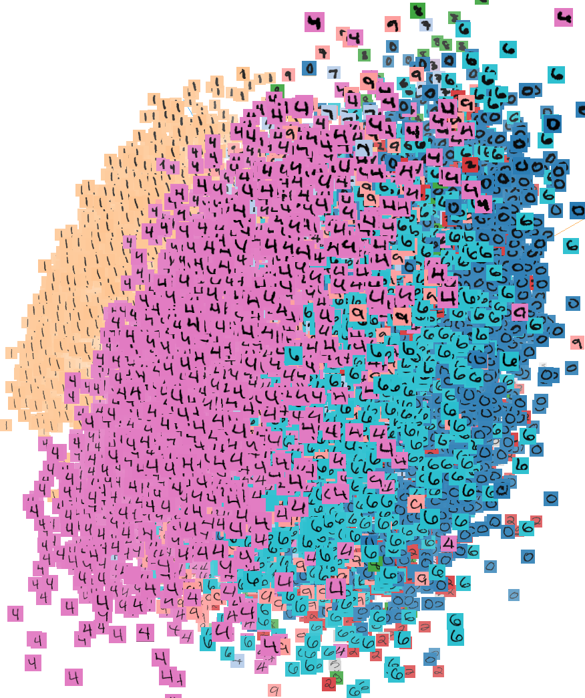
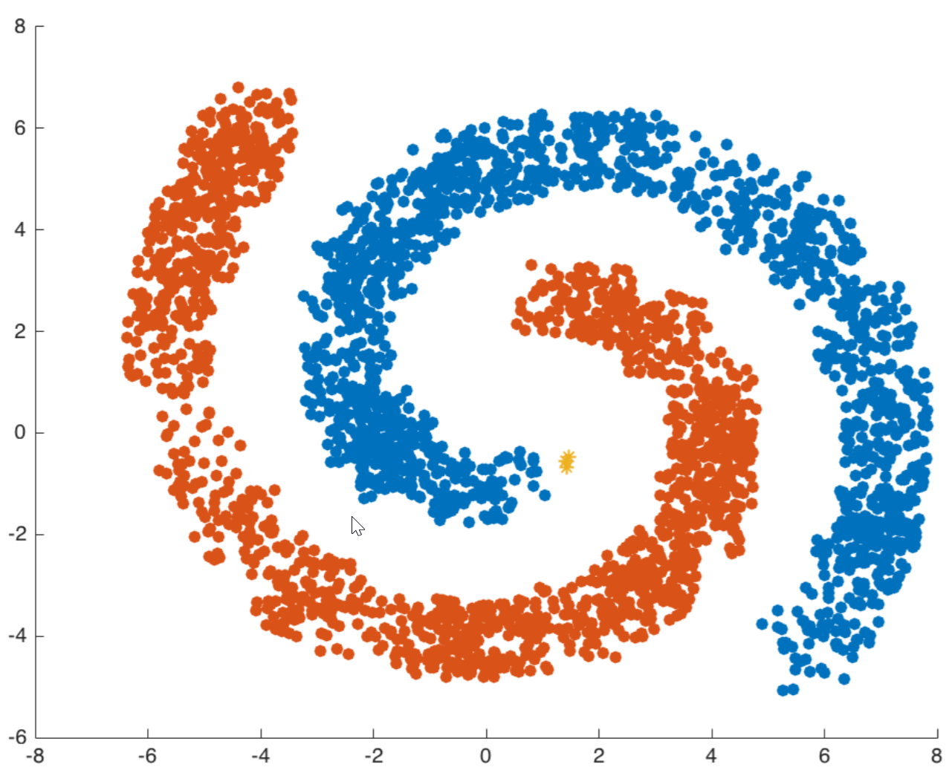
Unsupervised Learning
Finding intrinsic structures of the data
No labeled information is available
Examples: Clustering, Compression, Feature & Representation learning, Dimensionality reduction, Generative models ,etc.

Slide 3
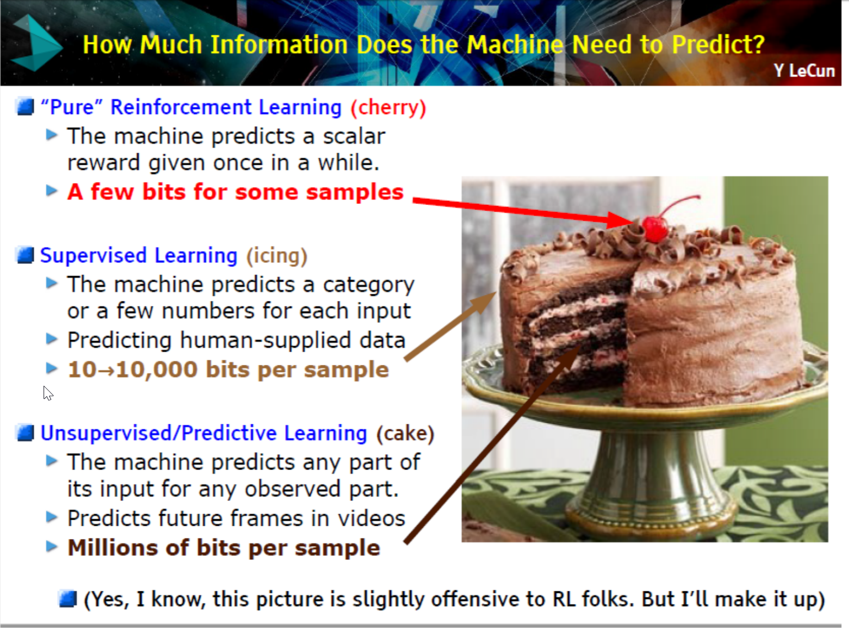
Unsupervised learning

Slide 4
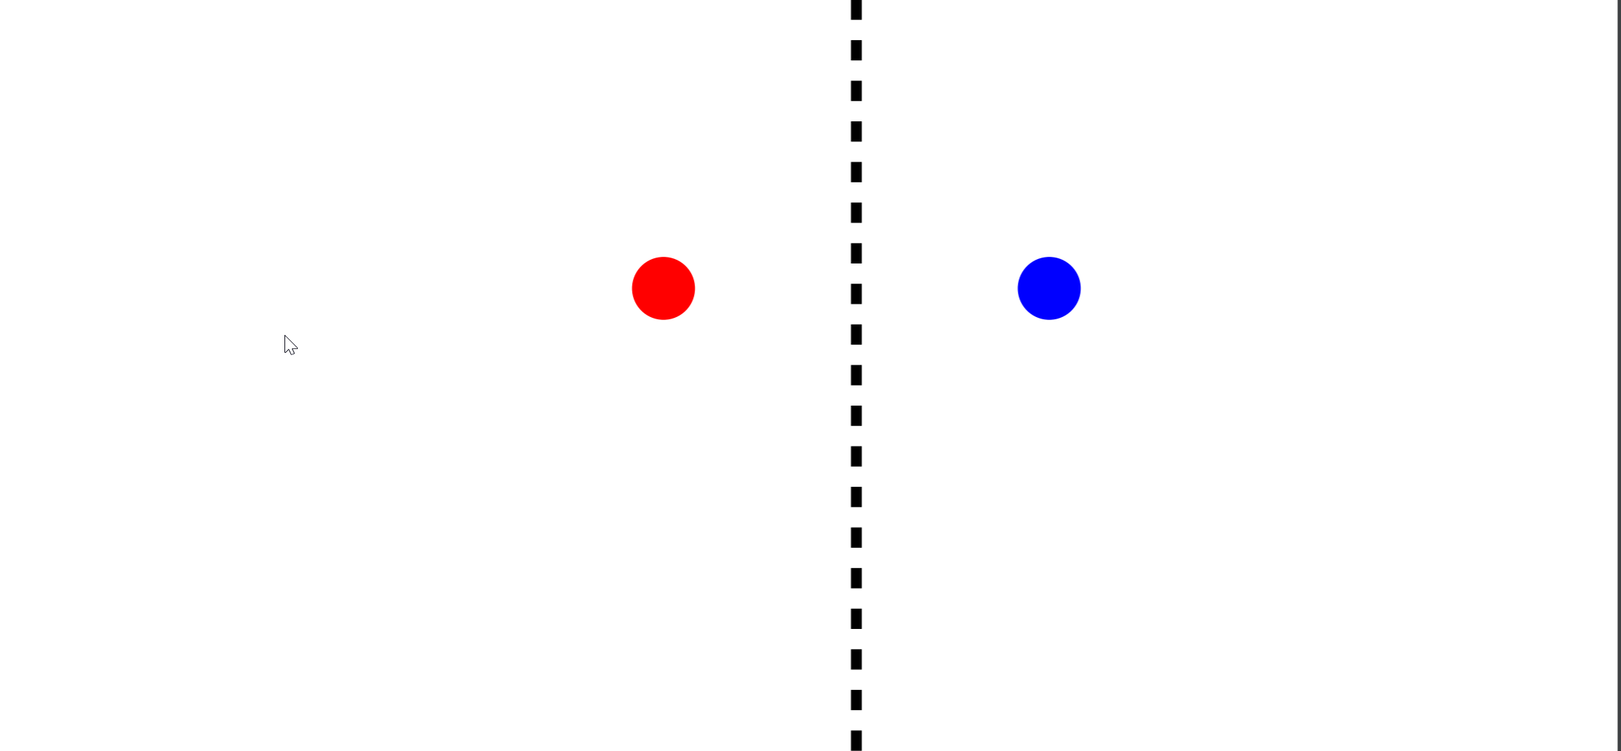
How unlabeled data may help

Slide 5
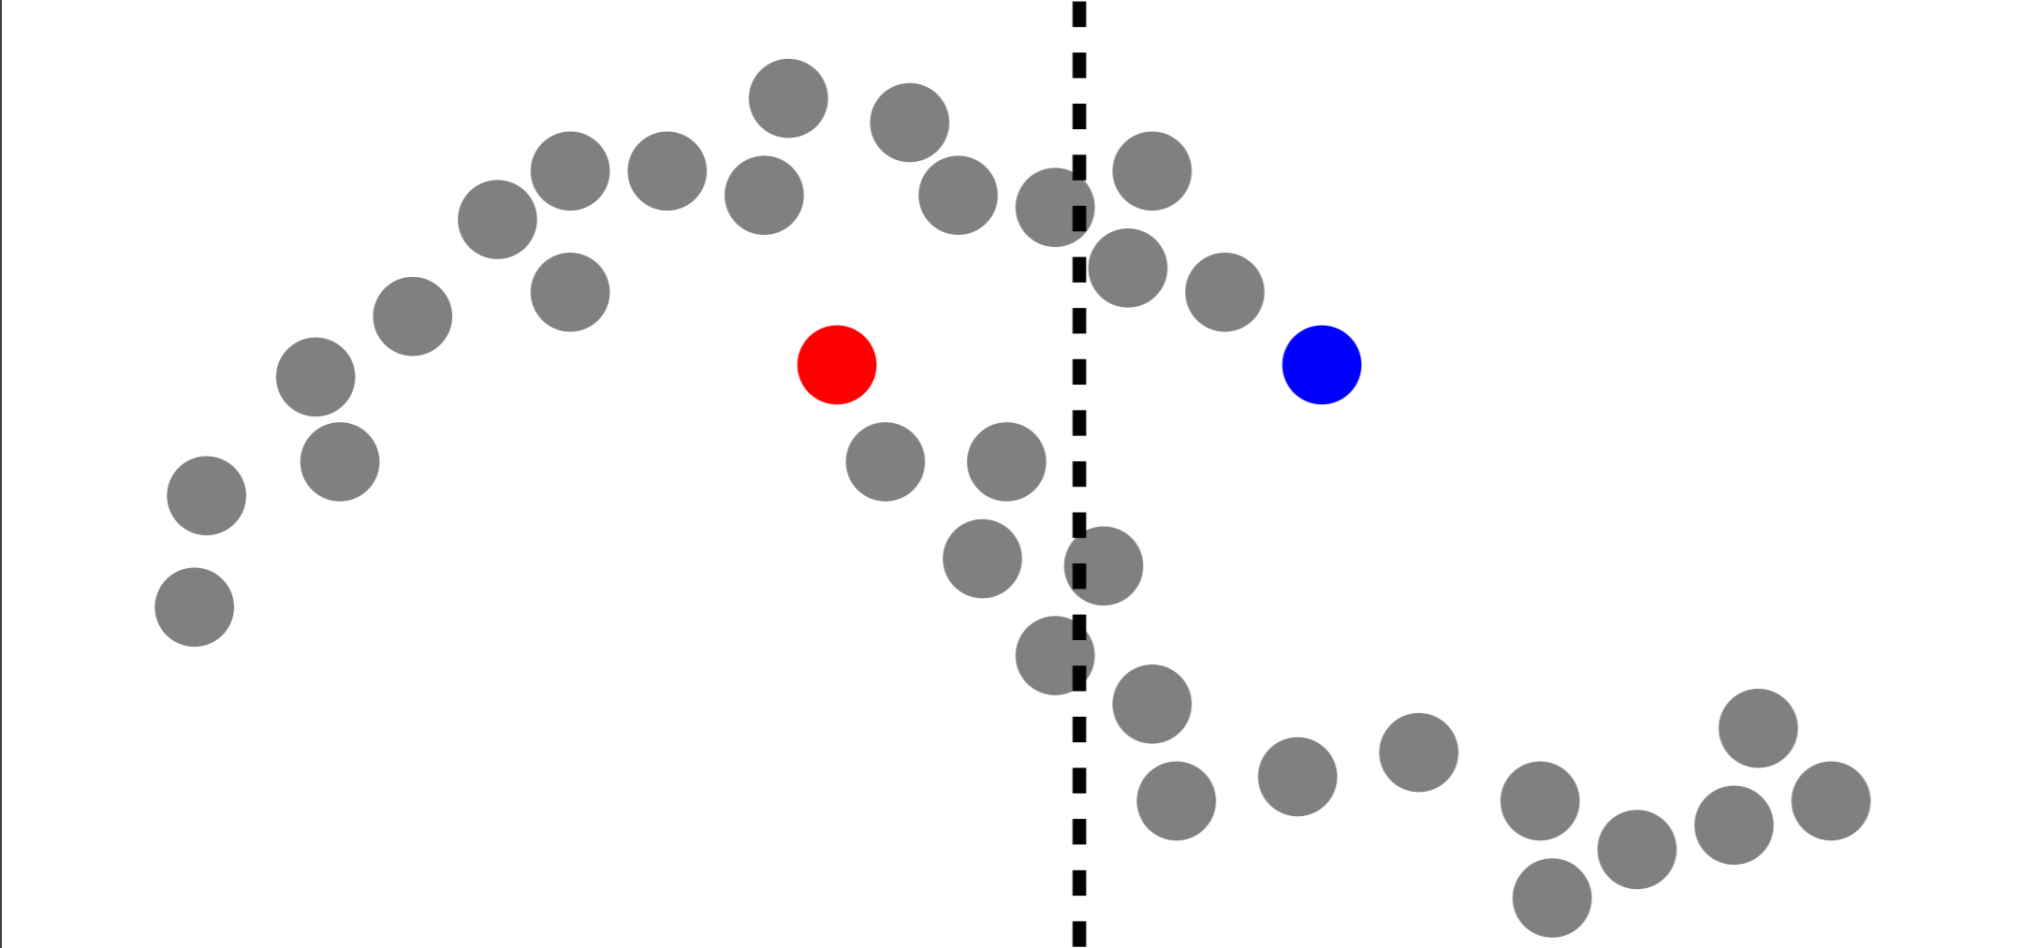
How unlabeled data may help

Slide 6
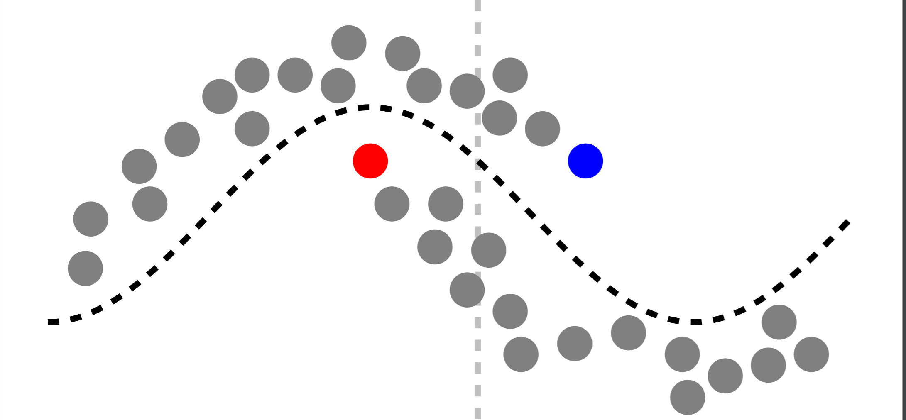
How unlabeled data may help

Slide 7
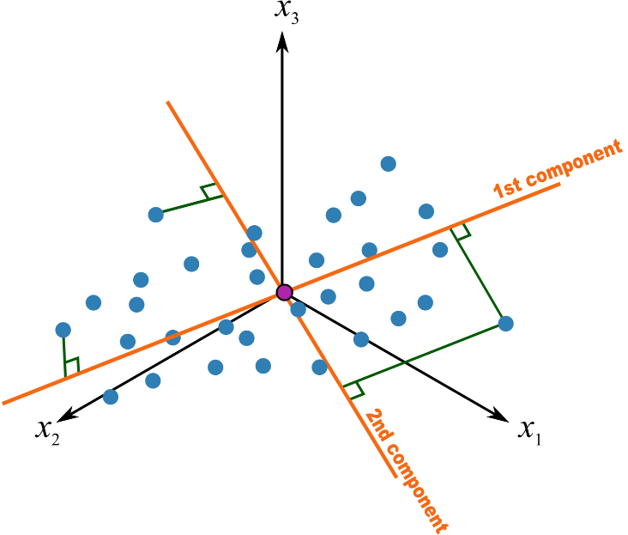
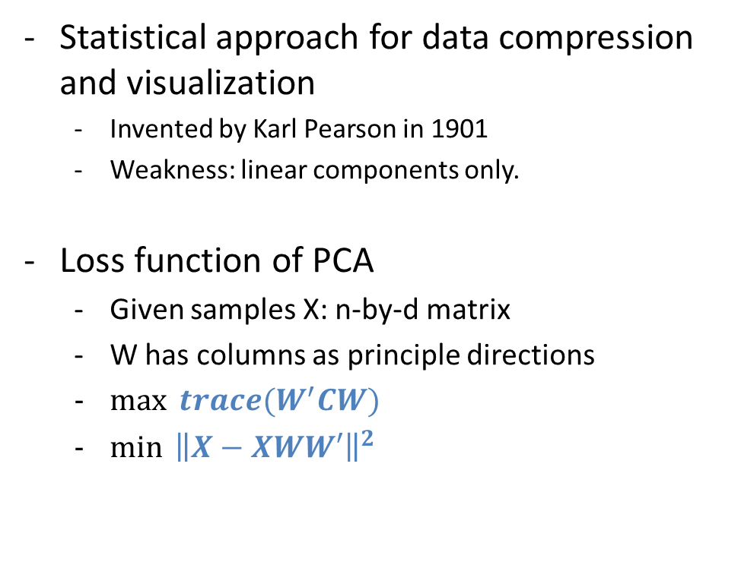
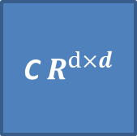
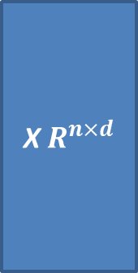
Principle Component Analysis
w2
Statistical approach for data compression and visualization
Invented by Karl Pearson in 1901
Weakness: linear components only.
Loss function of PCA
Given samples X: n-by-d matrix
W has columns as principle directions
$\max{ trace(W^{′}CW)}$
$\min{{ \left\|X−XWW′\right\|}^{2}}$
w1
Principal components
Data matrix
X$R^{n×d}$
Covariance
W1
W2
Wd
C $R^{d×d}$
The two objectives are equivalent if WW’ = I

Slide 8
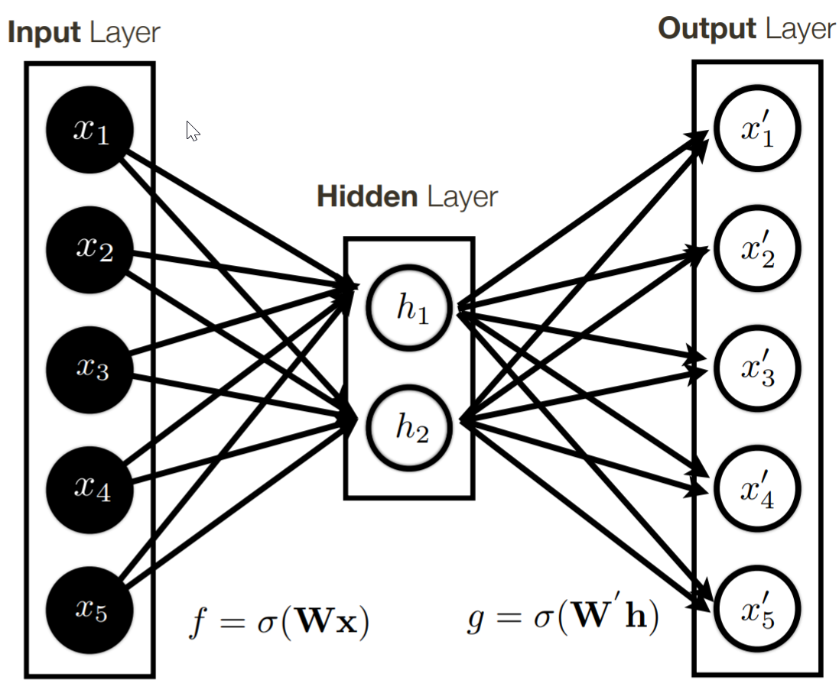
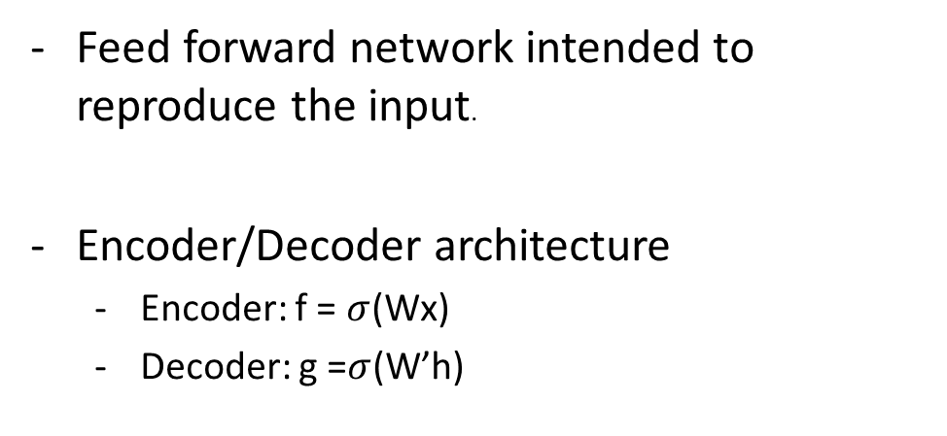
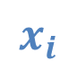
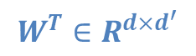
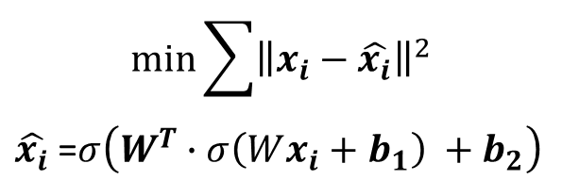
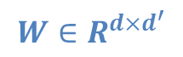
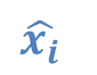
Autoencoder
Feed forward network intended to reproduce the input.
Encoder/Decoder architecture
Encoder: f = $σ$(Wx)
Decoder: g =$σ$(W’h)
$$x_{i}$$
$$\hat{x_{i}}$$
$$\min{\sum{{\left\|x_{i}−\hat{x_{i}}\right\|}^{2}}}$$
$\hat{x_{i}}$ =$σ\left(W^{T}∙σ\left(Wx_{i}+b_{1}\right) +b_{2}\right)$
$$W∈R^{d×d^{′}}$$
$$W^{T}∈R^{d×d^{′}}$$

Slide 9
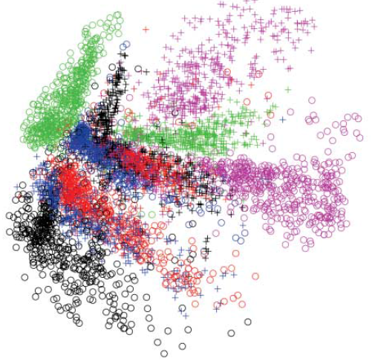
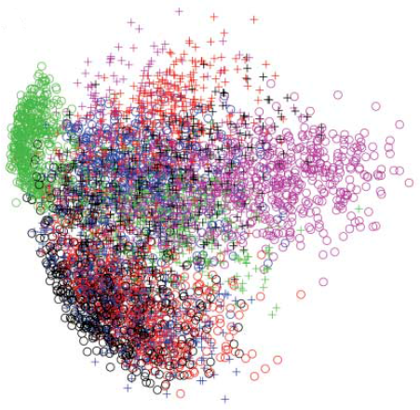
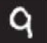
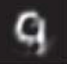
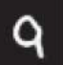
Deep Autoencoders
784
2
784
The codes are discriminative
784
1000
500
250
2
250
500
784
1000

Slide 10
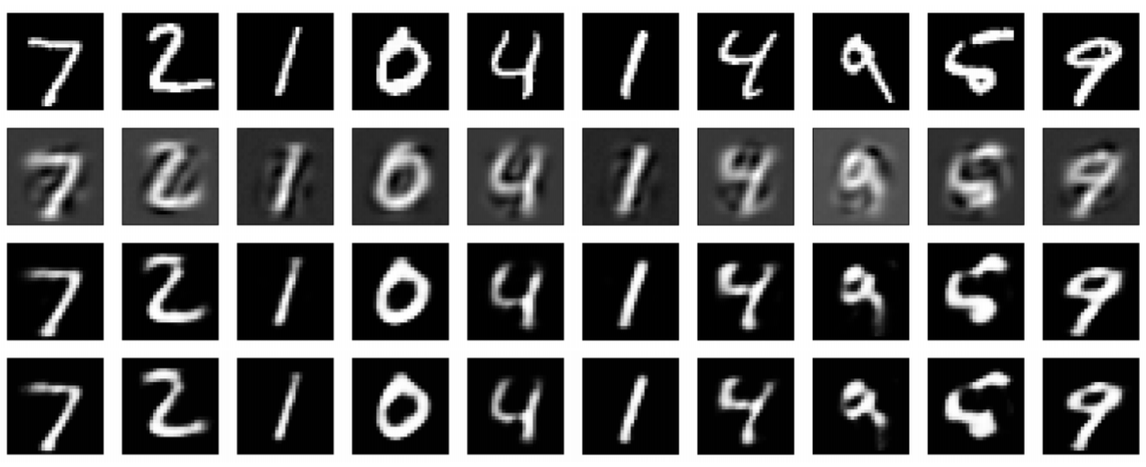
Deep Autoencoders
Deeper autoencoders can better reconstruct the input samples.

Slide 11
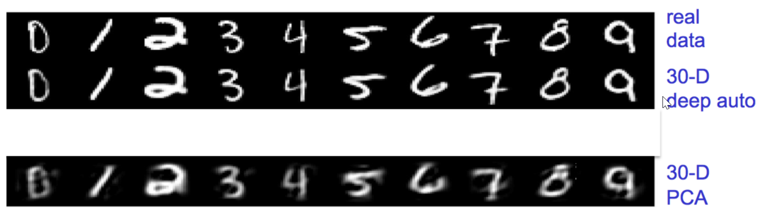
Network Structures
Hidden layer dimensions
Smaller than the input data:
Will compress the data with a bottleneck
Linear-linear encoder-decoder with Euclidian loss is equivalent to PCA
Nonlinear AE will be more powerful
Larger than the input data
No compression needed
Can trivially learn to just copy, no structure is learned
Does not encourage learning of meaningful features
But can still be useful by adding regularization!

Slide 12
Transfer function
Encoder usually chosen as sigmoid/RELU function
If inputs are binary variables (0,1)
Sigmoid function (for the decoder)
If inputs are real values
Output layer: no transfer function or linear
Other layers in decoder:
Tanh, Relu, or sigmoid function
Usually the input data are non-negative
Why we may not need zscore normalization here?

Slide 13
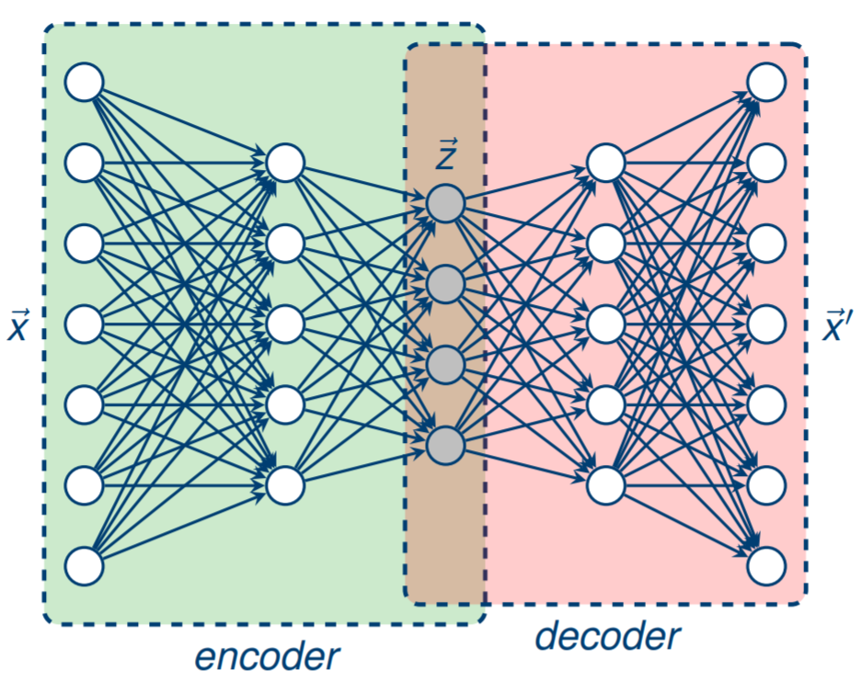
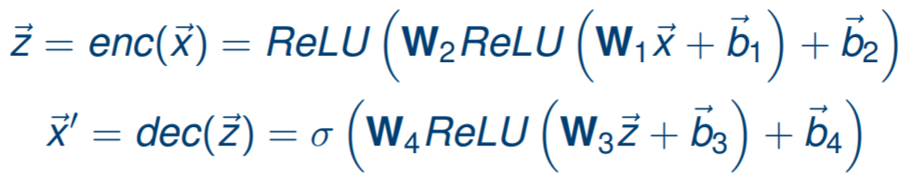
Stacked autoencoders

Slide 14
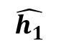
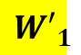
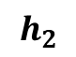
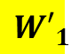
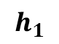

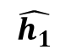
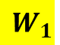
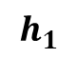
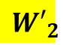
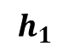
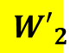
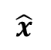
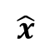
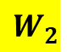
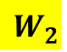
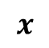
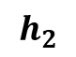
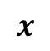
Layerwise Pre-training
Training can lead to poor local solutions
Very slow to train
Vanishing gradient: As the error is propagated backwards it gets very small
$$W_{2}$$
$${W′}_{2}$$
$$h_{2}$$
$$h_{1}$$
$$\hat{h_{1}}$$
$$W_{1}$$
$${W′}_{1}$$
$$h_{1}$$
$$W_{1}$$
$$W_{2}$$
$${W′}_{2}$$
$${W′}_{1}$$
$$x$$
$$\hat{x}$$
$$h_{2}$$
$$h_{1}$$
$$\hat{h_{1}}$$
$$x$$
$$\hat{x}$$

Slide 15
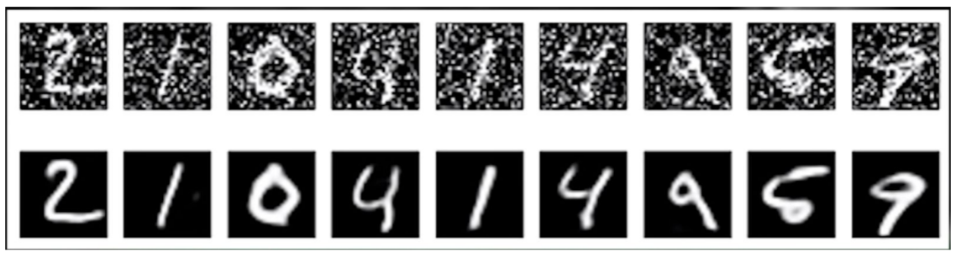
Denoising autoencoder
A good representation is one that can be obtained robustly from a corrupted input and that will be useful for recovering the corresponding clean input
The higher level representations are relatively stable and robust to the corruption of the input;
It is necessary to extract features that are useful for representation of the input distribution.
Take a partially corrupted input whilst training to recover the original undistorted input.

Slide 16
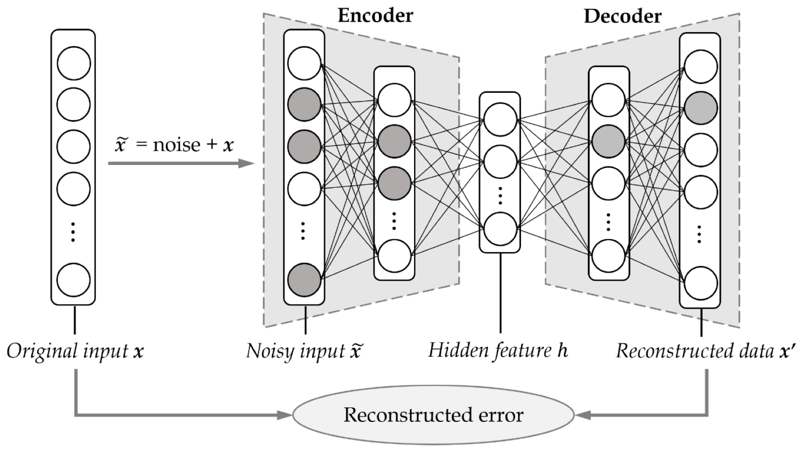
Denoising autoencoder

Slide 17
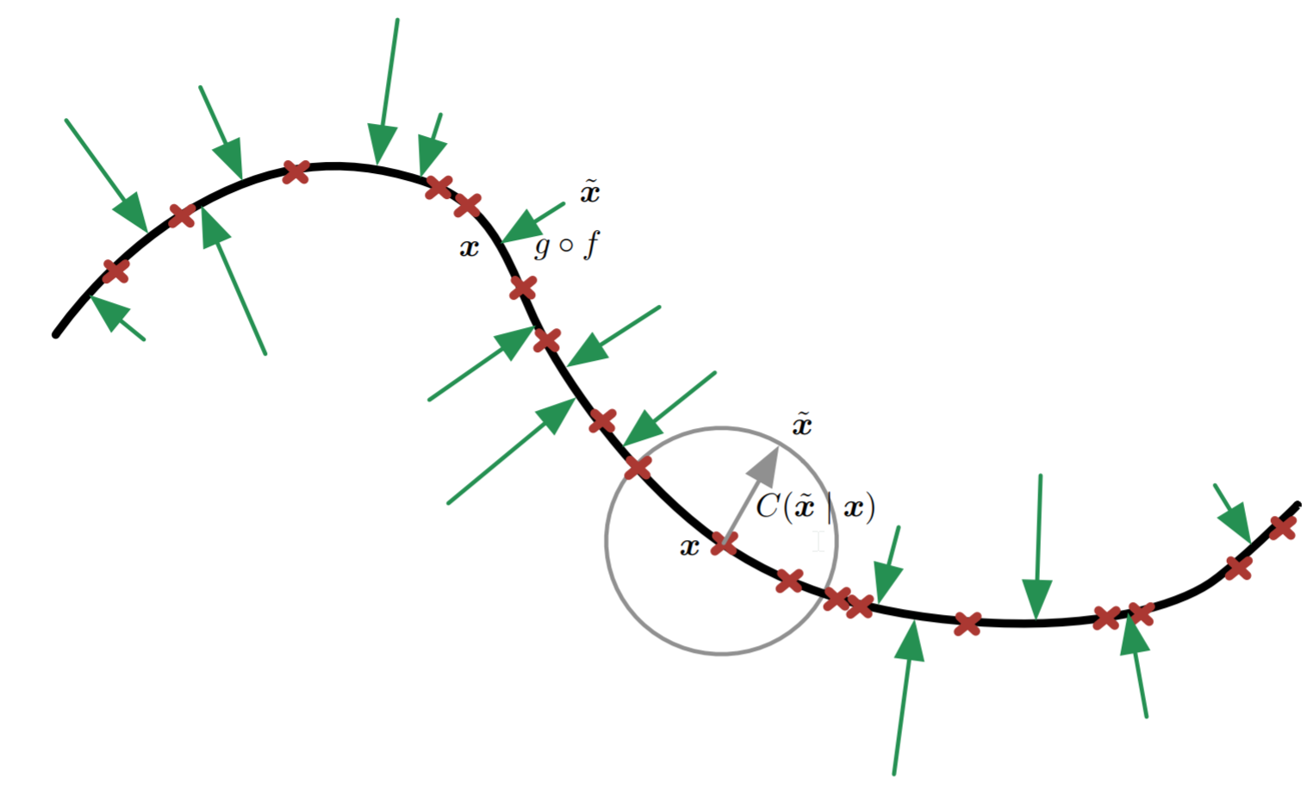
Denoising AE learns manifold structure

Slide 18
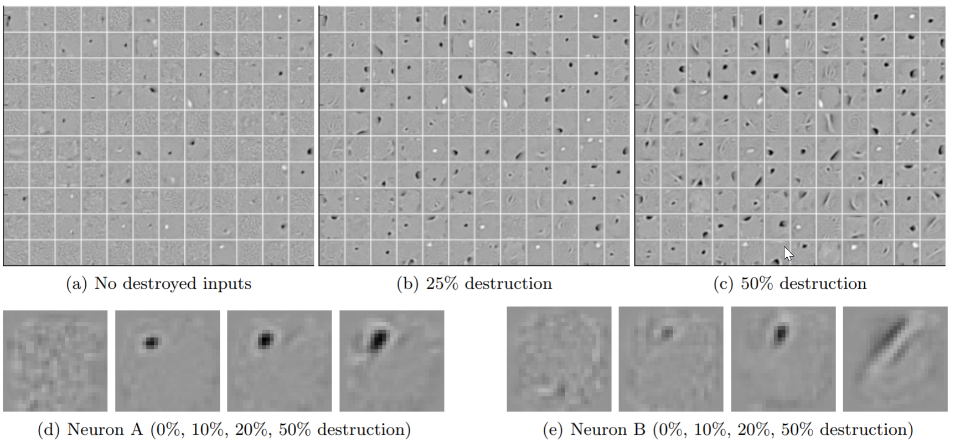
Denoising AE learns useful patterns
With no noise, many filters remain similarly uninteresting (undistinctive almost uniform grey patches).
As we increase the noise level, denoising training forces the filters to differentiate more, and capture more distinctive features.
Higher noise levels tend to induce less local filters, as expected. O

Slide 19
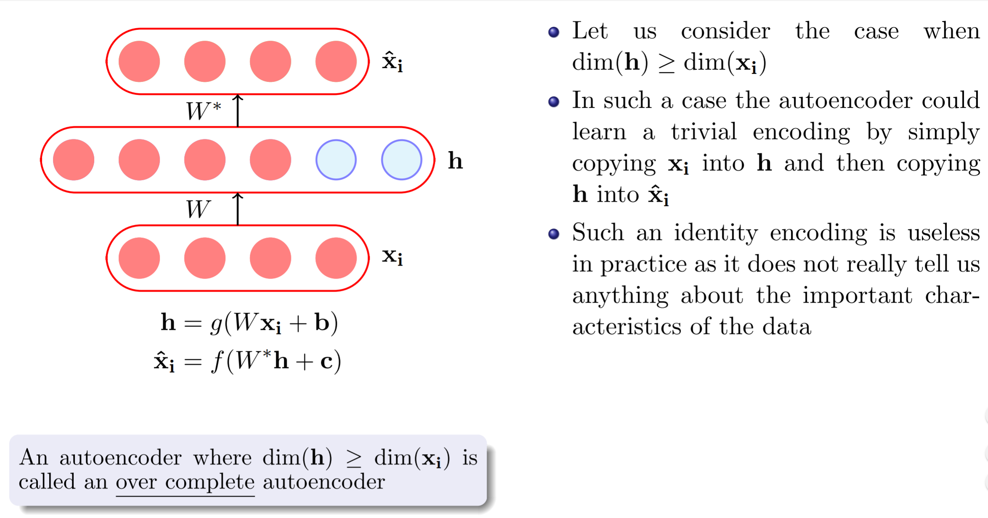
Sparse Autoencoder

Slide 20
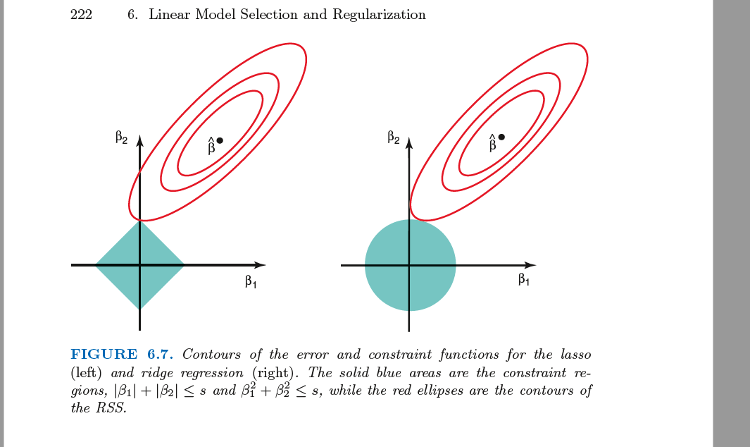

Sparse Autoencoder
Limit capacity of autoencoder by adding a term to the cost function penalizing the complexity of codes
a neuron as being “active” (or “firing”) if its output value is close to 1, or as being “inactive” if its output value is close to 0.
sparsity constraint: used to lower the activations of the hidden layers.
then they can specialize to detect certain features.
How to restricts the number of active neurons?
This is different than enforcing sparse models (LASSO).

Slide 21







Andrew Ng.’s method
Reference https://web.stanford.edu/class/cs294a/sparseAutoencoder.pdf
Average activation strength of the jth neuron in the hidden layer
We want $\hat{ρ_{j}}$ to be close to a small factor say $ρ_{}=0.05$
Kullback-Leibler (KL) divergence between a Bernoulli random variable with mean ρ and a Bernoulli random variable with mean $\hat{ρ_{j}}$.

Slide 22

K-Sparse Autoencoder
(Makhzani et al., 2013) picks the k-highest activated hidden nodes and 0s out the rest.
The error is then only back-propagated through the active nodes
Throughout training, k is set to a lower value each time so the appropriate neuron for each representation can be learned.
The features learned will also be more global with lower values of k. For higher values of k the features learned become more specific

Slide 23

K-Sparse Autoencoder
Filters of the k-sparse autoencoder for different sparsity levels k, learnt from MNIST with 1000 hidden units

Slide 24









Contractive Autoencoder
make the encoder robust to small changes in the input
adding a regularizing term to the cost function for the encoder.
Frobenius norm of the Jacobian matrix for the encoder activation sequence, with respect to the input
minimize
How to compute Jacobian
(sigmoid function)
$$x_{1}$$
$$x_{2}$$
$$x_{3}$$
$$x_{n}$$
$$h_{1}$$
$$h_{2}$$
$$h_{m}$$
$$W_{1}$$
$$h_{}$$
$$x$$
Reference: Contractive Auto-Encoders: Explicit Invariance During Feature Extraction, Salah Rifai et al., ICML 2011

Slide 25


Application of Autoencoders
Deep clustering
A good summarization of existing deep clustering algorithms
https://deepnotes.io/deep-clustering
$$\min{{loss_AE[g(f}_{θ}\left(x\right))]+{loss_kmeans[g}_{W,U}(z)}]$$
$z=$ $f_{θ}\left(x\right)$

Slide 26



Differentiable K-means
How to implement the K-means using gradient-based formulation?
originally implemented through discreet iterations
Objective
Are such iterations directly applicable in an end-to-end deep clustering framework?
E-step
M-step

Slide 27




Differentiable K-means
Optimizing cluster center W
u1 u2 … uk
x1
x2
x3
.
.
.
.
xn
W
D
What constraints on W?
What variables should be optimized?
Any relation between W and D?
Cluster indicator matrix
$W_{ij}:$ probability that xi belongs to cluster k
Distance matrix D
$$D_{ij}={\left\|x_{i}−u_{j}\right\|}^{2}$$
Towards K-means-friendly Spaces: Simultaneous Deep Learning and Clustering Bo Yang Xiao Fu Nicholas D. Sidiropoulos Mingyi Hong
Deep k-Means: Jointly clustering with k-Means and learning representations Maziar Moradi Fard, Thibaut Thonet, Eric Gaussier

Slide 28



Spectral Clustering
Cluster structures that k-means or even GMM fail to model
Spectral clustering (or embedding) can enhance cluster structures

Slide 29

Spectral Clustering
Embedding perspective
Given a graph G, with Adjacency matrix A, Laplacian matrix L
x_i’s are embedding coordinate for each node

Slide 30









Spectral Clustering
Vector x
1
1
1
-1
-1
-1
Graph-cut/clustering perspective
$$W_{ij}$$
Normalized cut
$$−$$
$$−$$
$$W_{ij}$$
$$\sqrt{D_{i}}$$
$$\sqrt{D_{j}}$$
$$D^{−\frac{1}{2}}LD^{−\frac{1}{2}}=D^{−\frac{1}{2}}\left(D−W\right)D^{−\frac{1}{2}}=I−D^{−\frac{1}{2}}WD^{−\frac{1}{2}}$$

Slide 31



Slide 32

More Considerations
In deep AE-based clustering, how to avoid arbitrary scaling in different layers of AE?
Optimization might want to push the scale of the bottleneck layer (on which clustering is performed) to zero, so that the clustering loss diminishes
How to prevent this trivial solution
How to initialize variables?
Cluster indicator matrix or cluster center
K-means clustering is only suited for spherical clusters
In practice clusters might be arbitrarily shaped
How to model irregular shaped clusters?
How to perform co-deep-clustering with AE?
Existing AE only performs transformation on one dimension (row or column) of the data matrix.
Is there a formulation to consider both dimensions?

Slide 33

Deep learning platforms
Easily build big computational graphs
Easily compute gradients in computational graphs
Run it all efficiently on GPU (wrap cuDNN, cuBLAS, etc)

Slide 34


Slide 35







Multi-modal representation
Modality refers to a certain type of information and/or the representation format in which information is stored.

Slide 36

Joint multimodal representation learning

Slide 37

Deep Multimodal Autoencoders
Reference [Ngiam et al., 2011 ]
Each modality can be pre-trained
using denoising autoencoder
To train the model, reconstruct both modalities using
both Audio & Video
— just Audio
— just Video

Slide 38

Multimodal Applications

